Slide 1
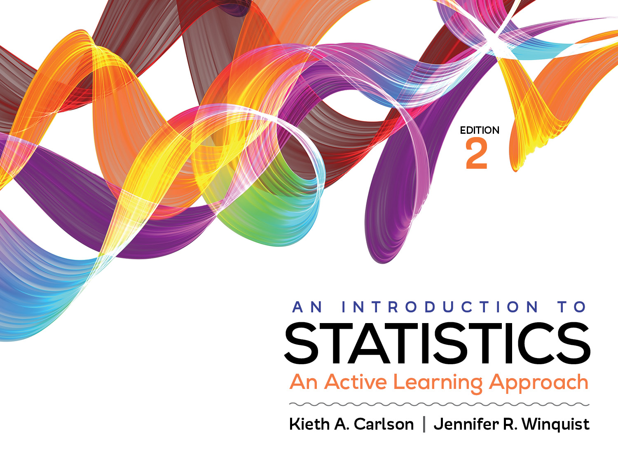
Introduction to Activity 11.4
Understanding Within- and Between-Group Variability

Slide 2
Activity 11.4 will require you to:
Describe within- and between-group variance within the context of an independent ANOVA
Identify things that increase and decrease each type of variance
Explain how high and low within- and between-group variance influences the F ratio

Slide 3
The scores are different within each treatment condition (More differences = greater within treatment variability)
Treatment Conditions
1 (No Violence) 2 (Low Violence) 3(High Violence)
3 7 12
3 10 10
4 8 14
2 8 11
3 7 13
M₁= 3 M₂= 8 M₃= 12
The means between the treatment conditions are different (More differences = greater between treatment variability)

Slide 4
F: The test statistic for ANOVA

Slide 5
If I wanted to increase the size of the F_{obtained} I would want to increase the variability in the _________ numbers and decrease the variability in the _________ numbers.
How could researchers change their study to accomplish this?
Treatment Conditions
1 (No Violence) 2 (Low Violence) 3 (High Violence)
3 7 12
3 10 10
4 8 14
2 8 11
3 7 13
M₁= 3 M₂= 8 M₃= 12
Notes:
Yellow
Blue

Slide 6
ANOVA summary table
If there were more variability in the yellow numbers, which of the following numbers would increase?
If there were less variability in the blue numbers, which of the following numbers would decrease?
Source | SS | df | MS | F
Between | 203.33 | 2 | 101.67 | 67.78
Within | 18 | 12 | 1.5
Total | 221.33 | 14

